Slide 1
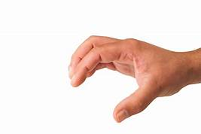
Conversation engine for deaf and dumb using ibm watson
TEAM DETAILS:
AKSHARA (18UK1A05B8)
NIRANJAN (18UK1A05D4)
AKHIL (18UK1A0598)
SHIVA KUMAR (18UK1A0585)

Slide 2
CONTEXT: 1.INTRODUCTION 2.PROBLEM 3.SOLUTION 4.METHODOLOGY 5.technology used 6.advantages&applications 7.conclusion

Slide 3
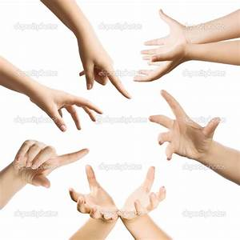
INTRODUCTION:
To establish a communication or interaction with Deaf and Mute people is of utter importance nowadays. These people interact through hand gestures or signs. Gestures are basically the physical action form performed by a person to convey some meaningful information. Gestures are a powerful means of communication among humans. In fact gesturing is so deeply rooted in our communication that people often continue gesturing when speaking on the telephone. There are various signs which express complex meanings and recognising them is a challenging task for people who have no understanding for that language. It becomes difficult finding a well experienced and educated translator for the sign language every time and everywhere but human-computer interaction system for this can be installed anywhere possible.

Slide 4
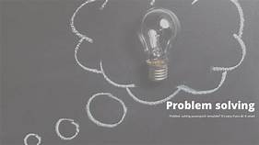
Problem???
our society we have people with disabilities.
Then technology is developing day by day but no significant developments and undertaken for the betterment of these people.
About nine billion people in the world are deaf and dumb
Communication between deaf-mute and a normal person have always been a challenging task.
Sign language helps deaf and dumb people to communicate with other people.
But not all people understand sign language.

Slide 5
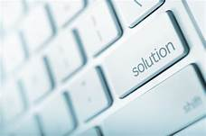
solution….
Hand gesture recognition system is widely used technology for helping the deaf and dump people.
Human hand has remained a popular choice to convey information in situations where other forms like speech cannot be used.
We aim for developing deaf and damp gesture recognize system for establishing communication between deaf and dumb people.
Gestures as considered as most natural expressive way for communication b/w humans & computers.

Slide 6
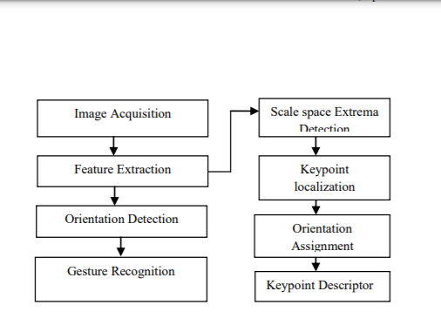
Methodolgy

Slide 7
Technology used:
Camera
Memory control
Feature extraction module
Gesture recognition module
Lcd display

Slide 8
ADVANTAGES &APPLICATIONS
The system implemented in the corresponding paper is very much essential due to the need of real time applications.Following are the advantages of proposed system:
REAL TIME FUNCTIONING
PORTABLE
NO NEED OF CALIBRATION
DOESN’T DAMAGE THROUGH USE
COMMUNICATION OF DEAF AND DUMB
SIGN LANGUAGE RECOGNITION

Slide 9
CONCLUSION:
As there are number of technologies are available for hand gesture recognition and speech recognition both having different features, applications and limitations. From above analysis we conclude that we can bridge the gap between the speech and hearing impaired people and the normal people which is very essential task. The propose system develops computer based intelligent system that will be helpful to deaf-dumb people to communicate with the other world using their natural hand gestures. This system is also used to converting the normal hand gesture as well as speech whatever someone gets speak into the text.

Slide 10
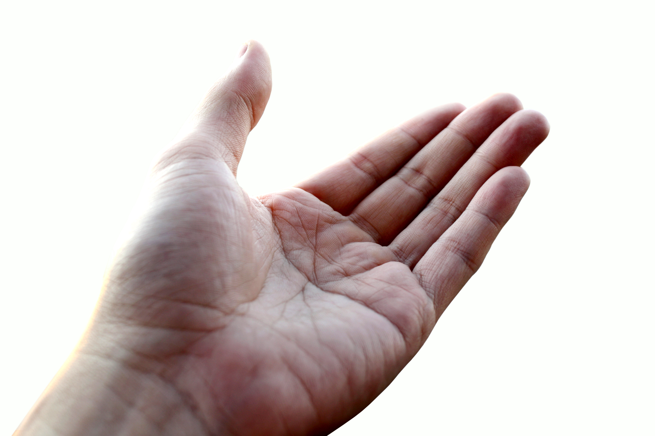
THANK YOU

